Slide 1
Patterns of Smart Device Usage
Exploring how Fitness Trackers are Used

Slide 2
Goal and Data Source
The purpose of this analysis is to determine how customers use smart devices
The data came from 33 random customers over a period of 31 days of smart device usage
Datasets included customer fitness tracker usage pertaining to daily activity, activity intensity, sleepday information, and weight information
The data was then placed into wide data format to separate time, date and usage into different columns where applicable
The formatted data sets were then put into Pivot tables for analysis

Slide 3
Analysis
The following metrics were studied: steps, distance traveled, calories burned, intensity, sleep, and weight
Each data point was aggregated per day of the 31 day study to determine the average number of times the customers recorded that metric
Overall participation rates was determined by how many customers appeared in each dataset, i.e. which customers did or did not use their device

Slide 4
Findings: Trends over Period of Study
Smart device values for the group as a whole generally stayed the same over time
This applied to all the metrics studied: Active minutes per day, calories burned per day, total steps per day, sleep time per day, and distance walked per day
Some activities were more often recorded by users than others.

Slide 5
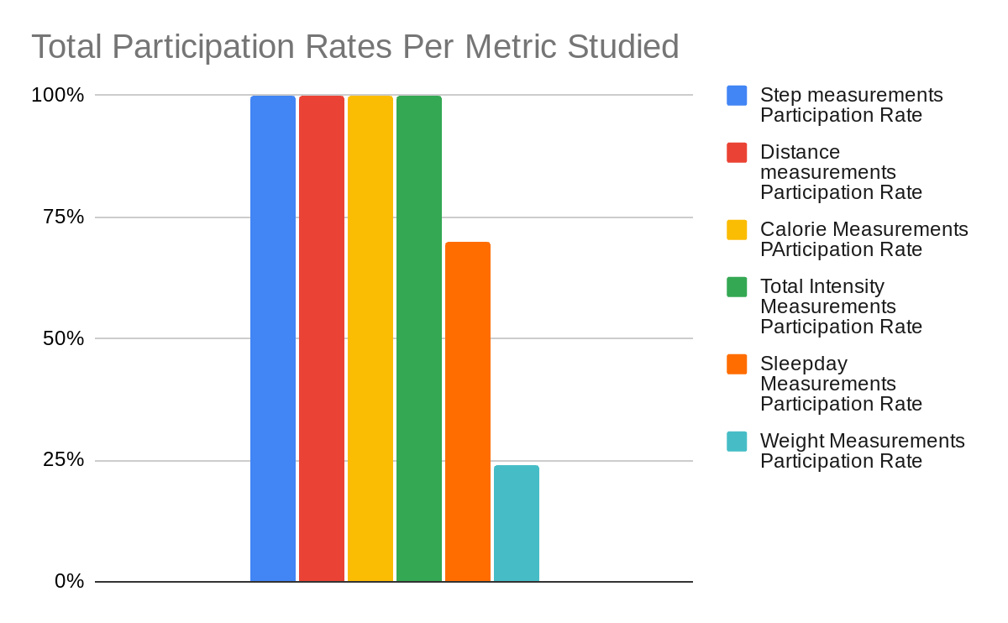
Findings: Participation Rates
Device participation rates were much greater among those tracking steps, distance, calories and total intensity; all recorded customers used the device for these measurements
Only about 70% of customers used the device for sleepday measurements at least once
Only about 24% of customers used the device for weight measurements at least once

Slide 6
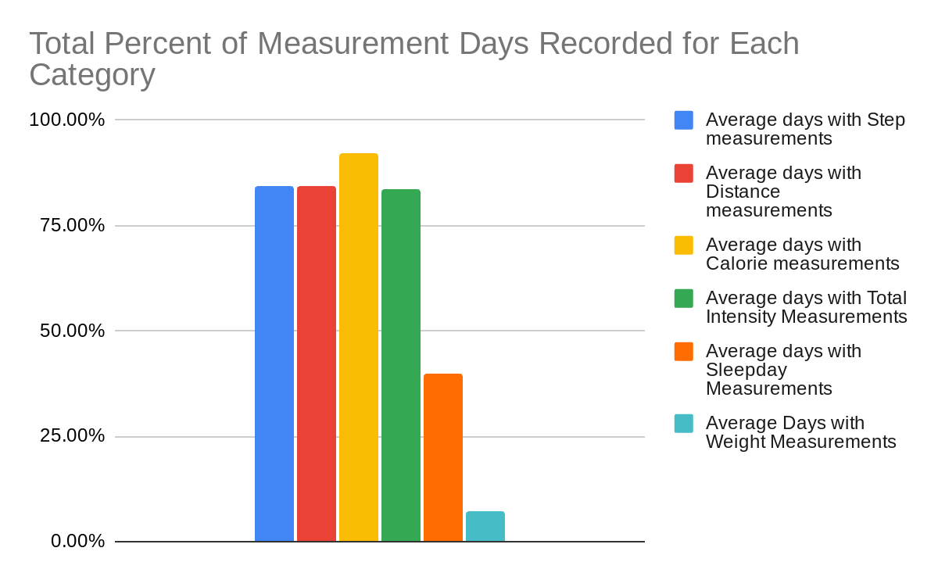
Findings: Total Frequency of Use
Calorie measurements were taken on about 92% of all possible days
Step, distance, and intensity measurements were recorded about 84% of possible days
Only 40% of possible days contained data for sleepday measurements
Only 7% of possible days contained records for weight measurements

Slide 7
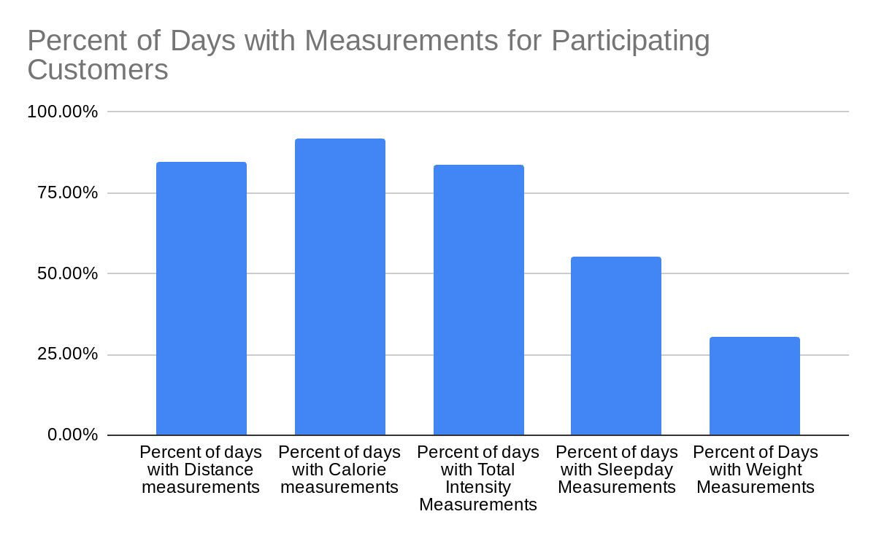
Findings: Frequency per Participating Customer
Among those who used the device for sleepday or weight measurements, their use was less frequent with these features than for the others
Those who used their device to record sleep metrics, on only about 55% of days were sleep measurements recorded
Those who recorded weight metrics, on only about 30% of days were weight measurements recorded

Slide 8
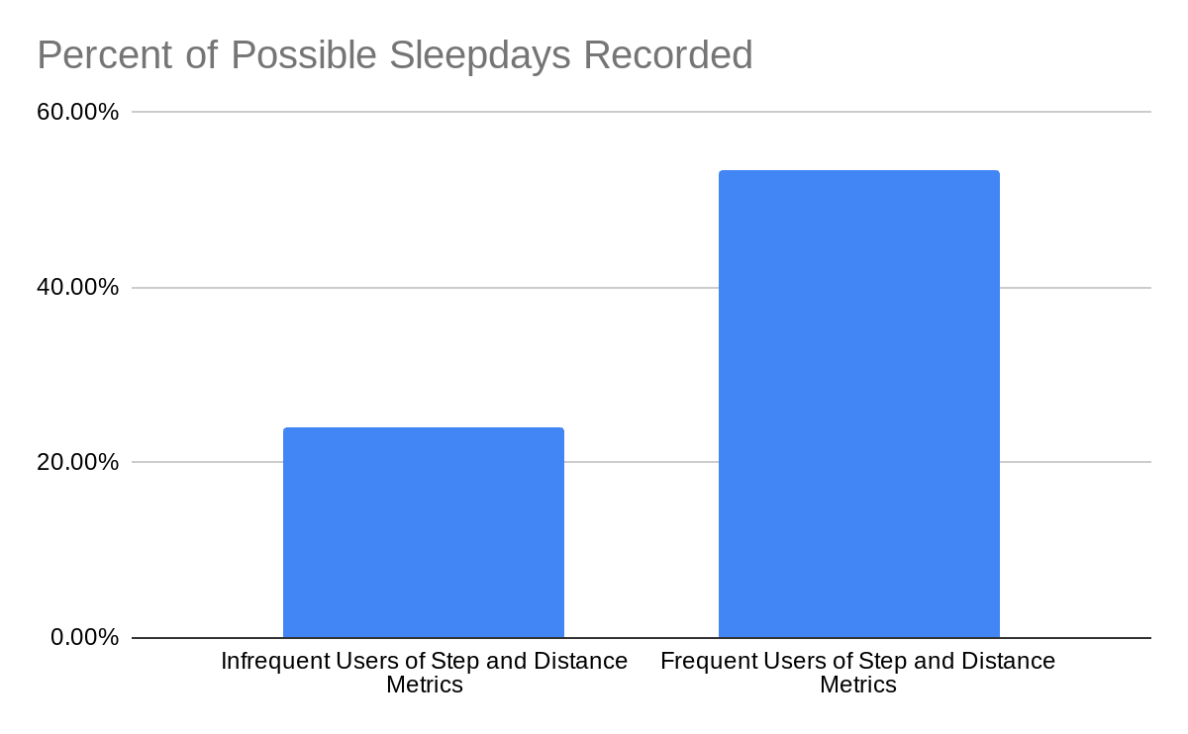
Findings: Frequent Vs. Infrequent users
Are frequent users in one area frequent users in other areas too?
Frequent users of step and distance functions were also considerably more likely to use the sleep measurement function than infrequent users
Among those 12 customers who recorded step and distance measurements for less than 80% of days, only about 24% of days had recorded sleep measurements
Among those 19 customers who recorded step and distance measurements for at least 30 out of 31 days, about 53% of days had recorded sleep measurements

Slide 9
Key Takeaways
Devices are often used by customers to track steps taken, distance travelled, calories burned, and exercise intensity
Users do not record sleep and weight measurements as often, even among those who use them occasionally for that purpose
Device usage has little effect on increasing exercise intensity as distance travelled and steps taken stayed relatively constant throughout study period
Frequent users of smart devices for steps taken and distance travelled are more than twice as likely to use these devices to record sleep measurements than infrequent users for those metrics

Slide 10
Recommendations
Taking all these factors into consideration, it makes sense to focus on marketing our fitness tracker products to measure calories burned, steps, distance and intensity of exercise
We should also focus on marketing our product to frequent users of other fitness trackers, particularly for those devices that emphasize less popular metrics such as sleep and weight measurements

